Slide 1
Mitigation of Bird Strikes in Aviation
Project Overview, Analysis, Findings and Conclusions
By – Deepshikha Singh
(DA41 Batch)

Slide 2
Problem Statement and Objectives
Problem statement:
Bird strikes pose a significant safety risk in aviation, leading to aircraft damage, delays, and financial losses.
The project aims to analyze past incidents to identify trends and develop mitigation strategies.
Objective:
Understand the frequency and severity of bird strikes.
Identify high-risk locations and times/trends of Bird Strikes.
Provide data-driven recommendations for prevention.

Slide 3
Technologies used & Observations and data pre-processing
Technologies used :
Python ( with Pandas lib): for data cleaning and categorization
Tableau: for data analysis and visualisation
Observations and Data Pre-processing:
Dataset: 25,558 wildlife strike records, enabling detailed analysis.
Key Columns: Wildlife: Species (complete) for species impact, Phase of Flight and Impact to flight to identify high-risk moments, Cost: Total $ for financial impact, and Number of People Injured and High-risk locations for risk assessment.
Data Cleaning: Missing values handled—categorical (mode), numerical (median/mode), and unknown data labeled as "Unknown".
FlightDate forward-filled after thoroughly analyzing the data for consistency.
Added ‘Country’ column to specify the origin states.

Slide 4
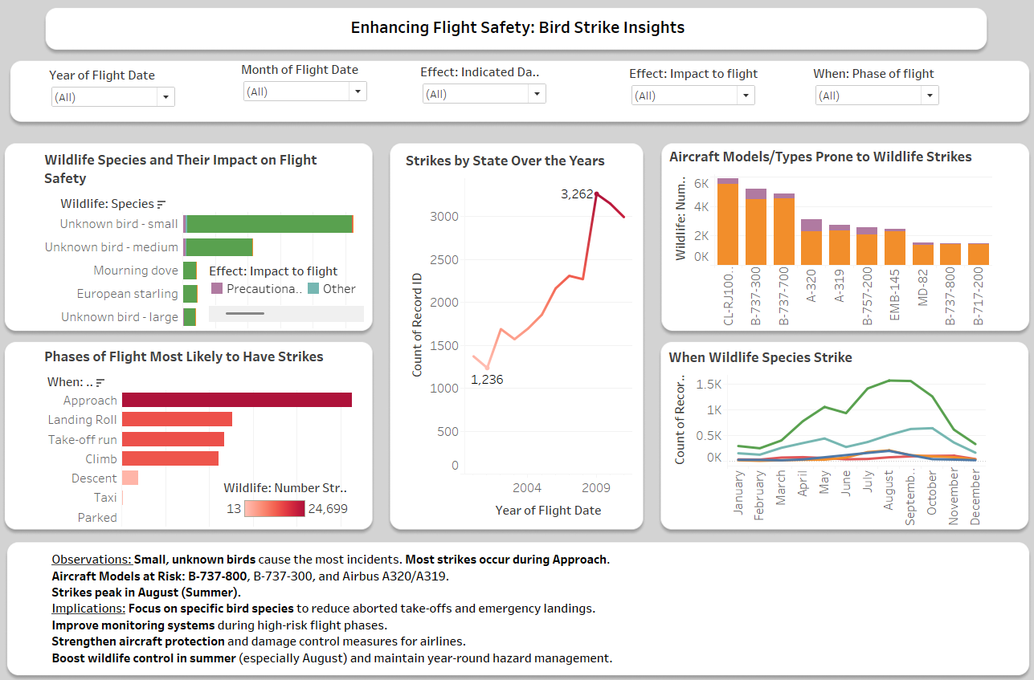
Enhancing Flight Safety: Bird Strike Insights

Slide 6
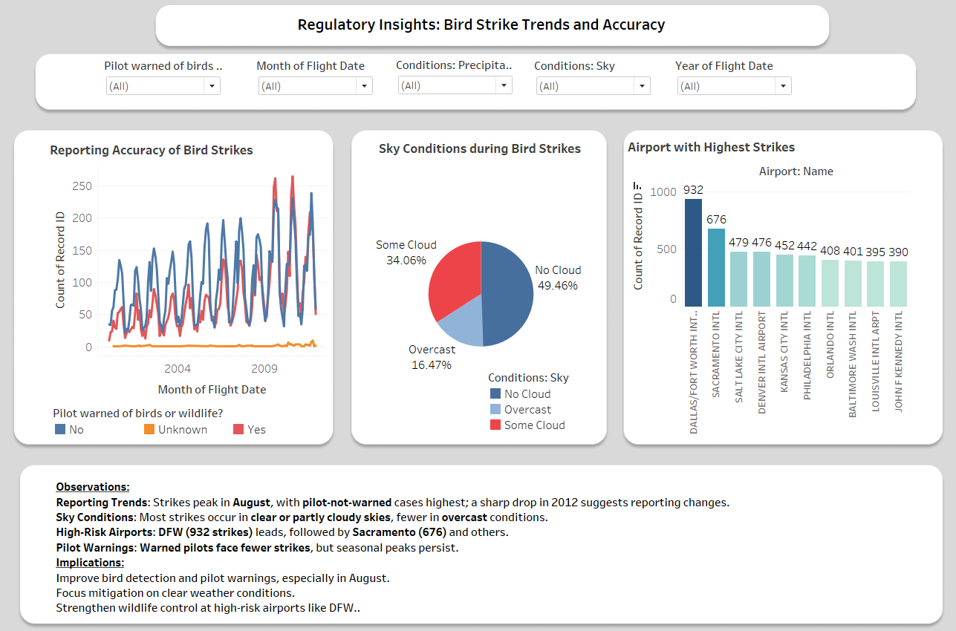

Slide 7
Flight Safety & Regulatory Compliance
1. Which wildlife species are most involved in bird strikes, and how do they impact flight safety?
Small, unknown birds cause most "no effect" incidents, while red-tailed hawks and vultures cause significant damage.
2. During which phases of flight are bird strikes most likely to occur?
Approach, climb, and takeoff are the most vulnerable phases.
3. have bird strike trends changed over the years?
Significant increase from 2003 to 2009, peaking at 3,262 incidents.
4. How does seasonality affect bird strike frequency?
August records the highest strikes due to increased bird activity.
5. How well are bird strike incidents reported in compliance with aviation safety regulations?
Many incidents occur without prior pilot warnings, impacting safety measures.
6. Which airports report the highest number of bird strikes?
Dallas/Fort Worth (DFW) leads with 932 bird strikes, followed by Sacramento and Salt Lake City.
7. How can we improve reporting accuracy and timeliness of bird strike incidents?
Implement automated detection systems and enhance pilot reporting protocols.

Slide 8
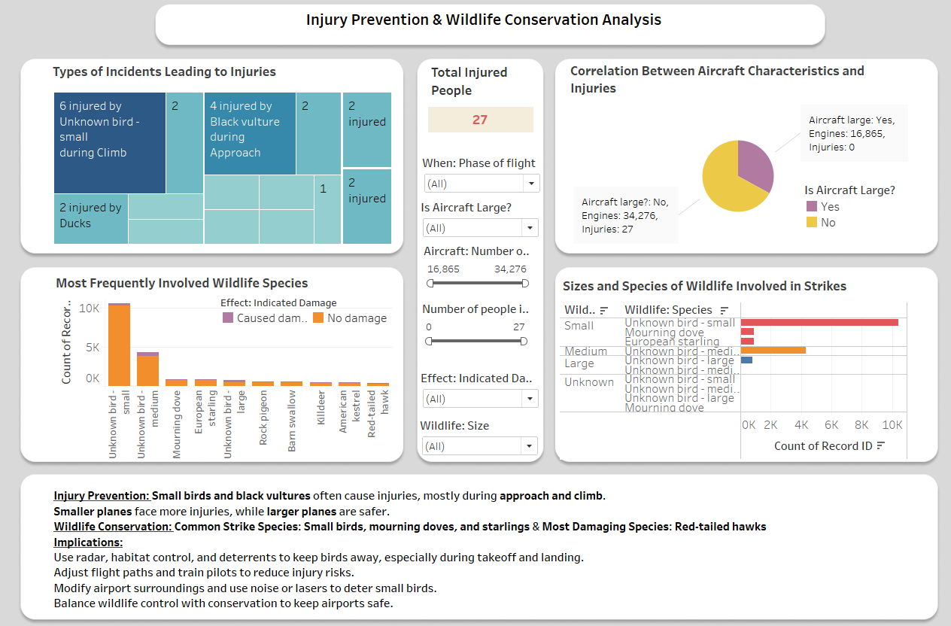

Slide 9
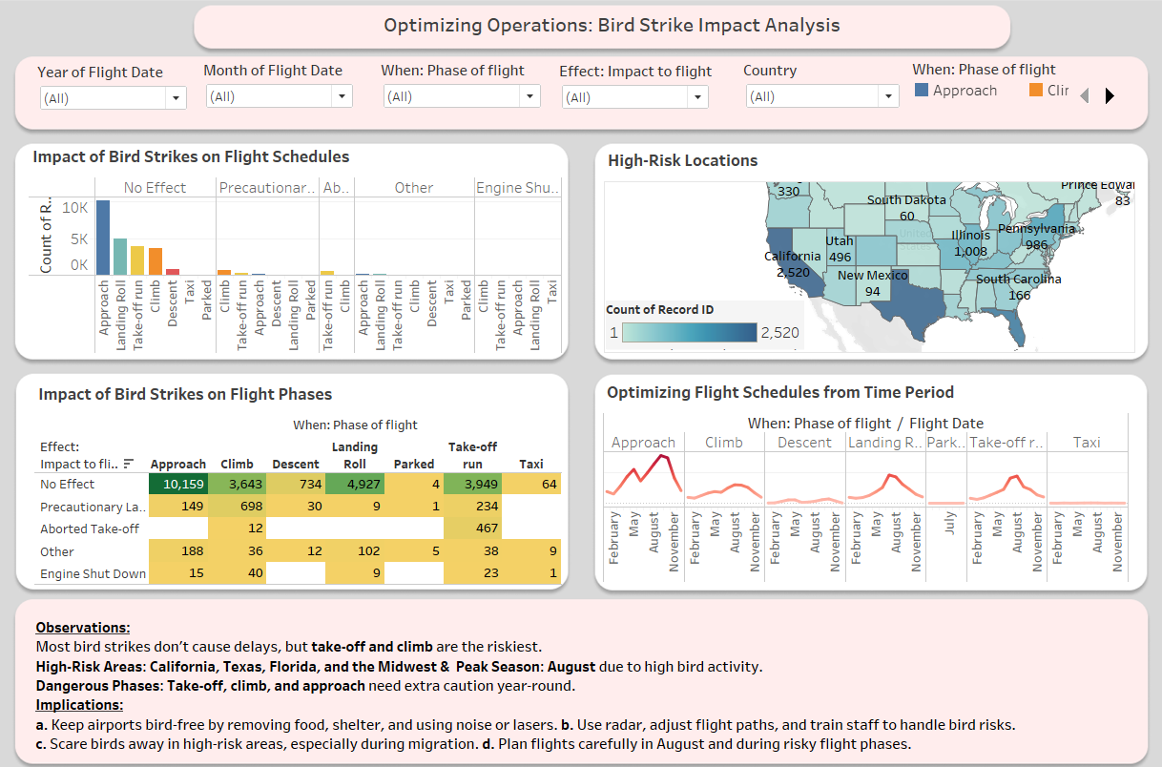

Slide 10
Wildlife Trends & Environmental Risks
1. Which bird species are most frequently involved in strikes?
Small, unknown birds dominate, followed by mourning doves and European starlings.
2. How does habitat modification around airports help reduce bird strikes?
Removing food sources and water bodies makes airports less attractive to birds.
3. Which states have the highest number of bird strikes?
Texas, California, and Florida report the most incidents due to bird migration patterns.
4. How do environmental factors like weather and sky conditions affect bird strikes?
Clear skies and partial cloud conditions see the highest incidents.
5. What are the best strategies for wildlife management to minimize aviation risks?
A mix of habitat control, deterrents (lasers, noise), and real-time bird monitoring is most effective.
6. Can adjusting flight schedules reduce the likelihood of bird strikes?
Avoiding peak bird activity periods (dawn, dusk, summer months) can minimize risks.
7. Are there specific flight routes or locations with higher risks of bird strikes?
Airports near water bodies, forests, and migratory routes face increased risks.

Slide 11
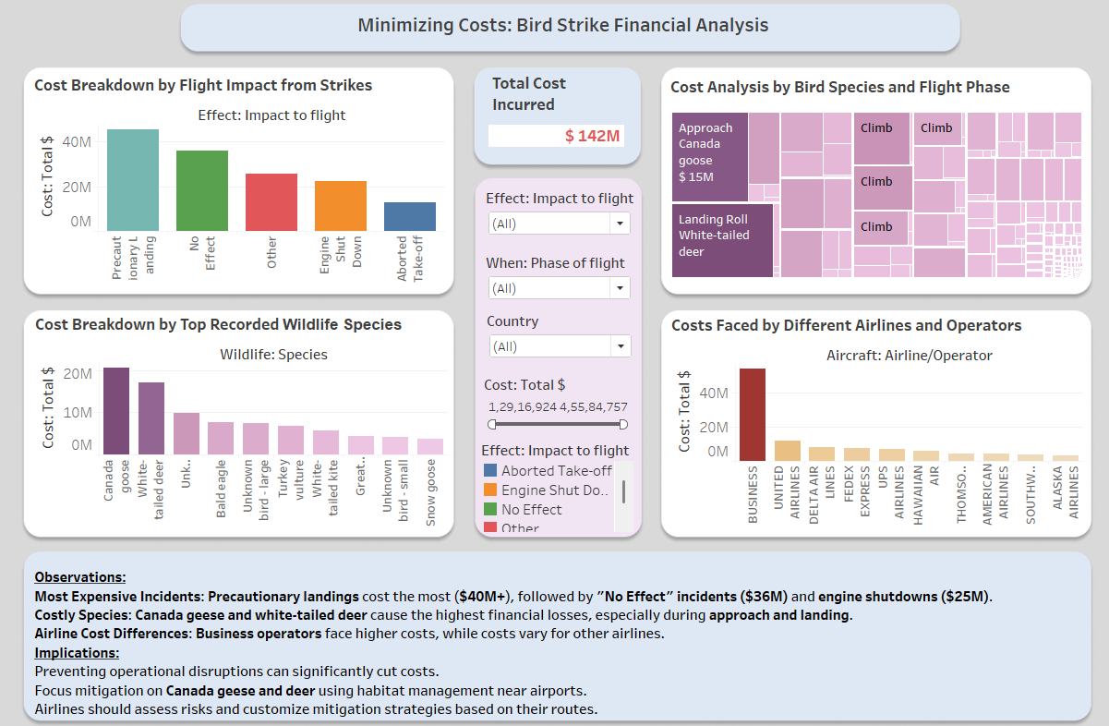

Slide 12
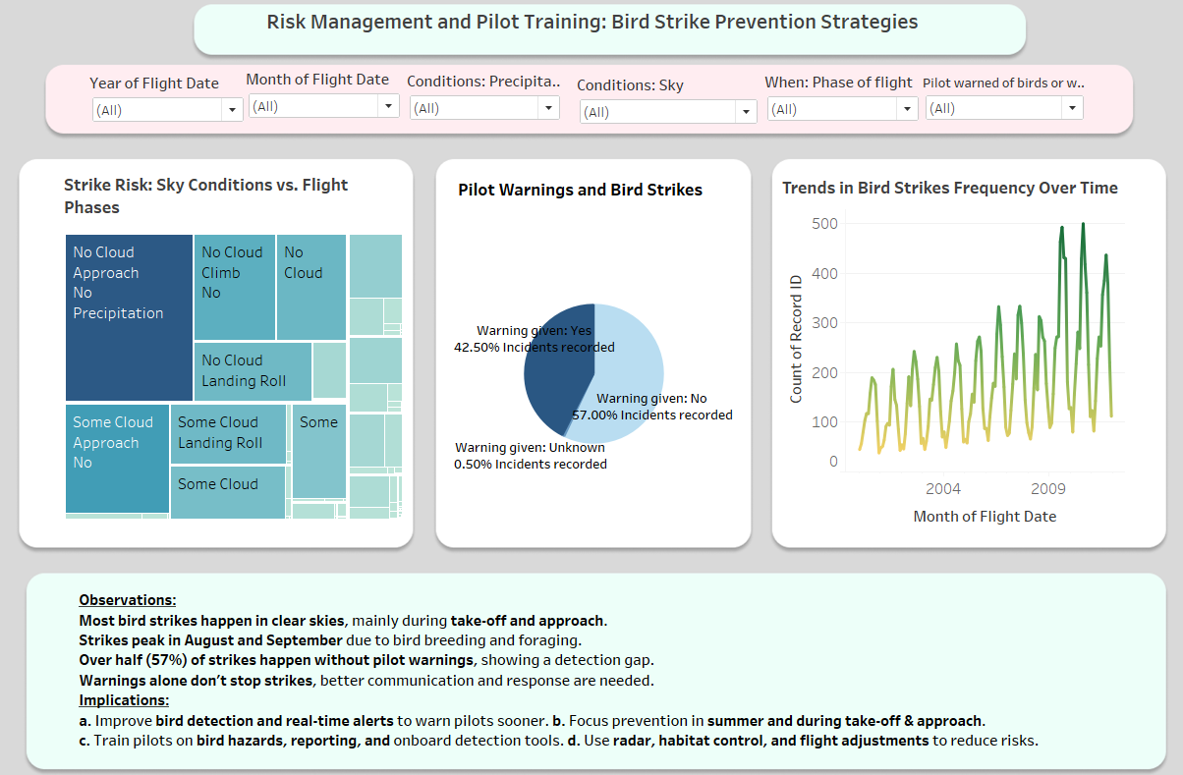

Slide 13
Cost, Risk Management & Training
1. What is the estimated economic impact of bird strikes on airlines?
Over $40M in costs due to precautionary landings and aircraft damages.
2. Which aircraft types are most affected by bird strikes?
B-737-800 and Airbus A320/A319 report the highest incidents.
3. What are the most cost-effective measures to prevent bird strikes?
Focusing on mitigating risks from Canada geese and large birds to reduce financial losses.
4. How can pilot training and awareness help reduce bird strikes?
Enhancing real-time reporting and response to bird hazards can improve safety.
5. How can predictive analytics help minimize bird strike risks?
Historical data like this can be used to forecast high-risk periods and adjust flight operations accordingly.
6. How effective are current bird detection and avoidance systems?
Radar, AI-based monitoring, and automated deterrent systems can significantly reduce strike incidents.
7. What communication strategies can improve pilot responsiveness to bird strike risks?
Real-time alerts, AI-driven risk assessments, and improved coordination with air traffic control.

Slide 14
SUMMARY OF THE ANALYSIS
Peak Strike Periods: Highest in August & September, mainly in clear skies, coinciding with high bird activity and migration periods.
High-Risk Flight Phases: Occur mostly during approach, climb, and takeoff , when aircraft are at lower altitudes and birds are active. Precautionary landings are often necessary for larger bird strikes.
Aircraft & Airport Risks: Smaller aircraft (B-737-800, B-737-300, A320/A319) are more affected.
High-risk airports: DFW, Sacramento, High-Risk Locations: California, Texas, Florida, and the Midwest.
Pilot Awareness Gap: 57% of strikes occur without pilot warnings, highlighting detection issues.
Financial Impact: Precautionary landings ($40M), engine shutdowns ($25M); Canada geese and deer cause the highest costs.
Wildlife Hazards: Unknown Small birds, mourning doves, and red-tailed hawks frequently strike aircraft, with hawks causing severe damage.

Slide 15
Conclusion & strategies
Improve Bird Detection & Warnings: Deploy radar systems, real-time alerts, and enhanced pilot training to reduce strike risks.
Enhance Wildlife Management: Modify airport surroundings to deter high-risk species (Small birds, Canada geese, hawks) using lasers, noise deterrents, and habitat control.
Address Seasonal & Migration Risks:
Peak migration periods (August-September) require heightened monitoring.
Adjust flight paths during migration seasons to minimize encounters with large flocks.
Focus on High-Risk Locations: Strengthen mitigation efforts at DFW, Sacramento, and California, Midwest regions, where strikes are most frequent.
Operational & Policy Adjustments:
Standardize reporting for better data accuracy and trend analysis.
Develop airline-specific risk mitigation plans based on flight routes.
Expected Outcomes: Fewer bird strikes, reduced aircraft damage, lower operational costs, and enhanced flight safety. Better balance between aviation safety and wildlife conservation.

Slide 16
ThANK YOU

